Slide 1
CMS History Timeline
1993-2019

Slide 2
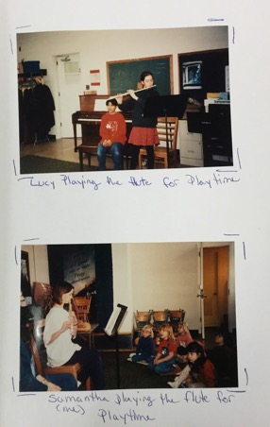
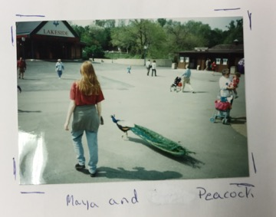
1994 - 1995
The students traveled to the Art Museum of St. Louis and the St. Louis Zoo.
They played games such as checkers, chess, and cards at lunch.
There was also a time of the day called “Playtime” when the students performed for each other.
They got a soda vending machine for their school.

Slide 3
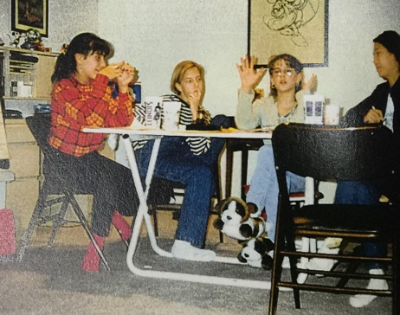
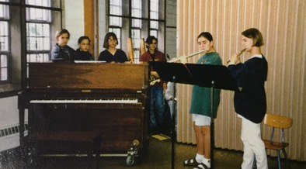
1995 - 1996
10 new students.
Uni teachers taught PE at Kenny Gym.
Physics classes were taught at Loomis Lab, Beckman, and NCSA.
A student council was formed. They collected dues of $1 at meetings and donated to the American Cancer society.
The students planned overnights and performed for the preschool classes at Wesley United Methodist Church.

Slide 4
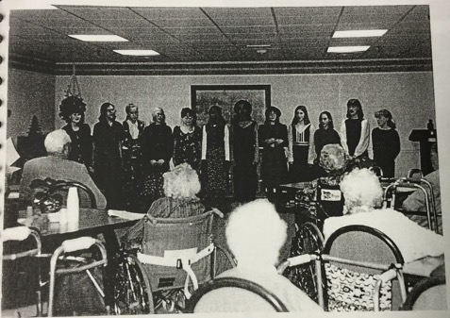
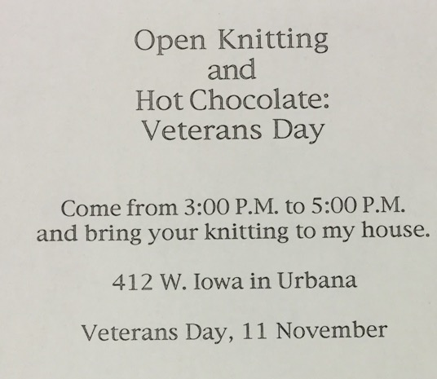
1996 - 1997
The students took field trips to Clark Lindsey, Conner Prairie, and Krannert Center for the Performing Arts.
Students performed the play Alcestis
Brigitte Pieke held an Open Knitting and Hot Chocolate event at her house for Veterans’ Day.

Slide 5
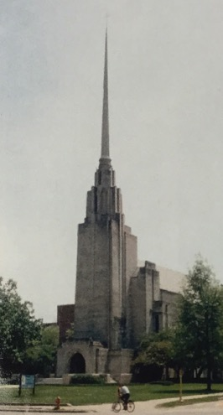
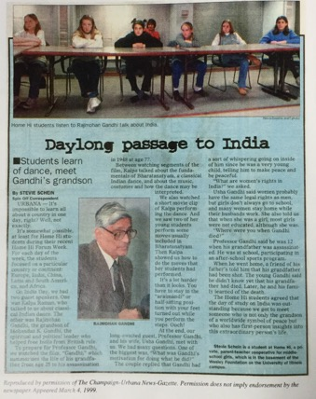
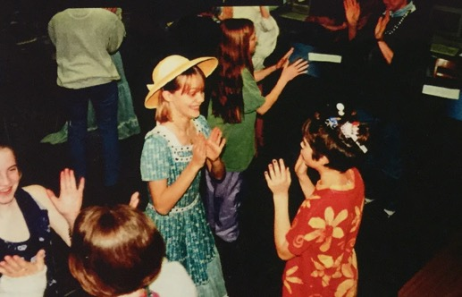
1998 - 1999
Home Hi was still located in the basement of the Wesley Foundation. The students walked to Kenney Gym for PE.
That year’s Forum Week theme was “Around the World in Five Days”. They made a European lunch, met with a grandson of Mohandas Gandhi, and folded Mexican paper flowers.
Their classes were English, French, science, history, math, music, art, and physical education.
They traveled to Turkey Run, Homer Lake, the Art Institute of Chicago, and the Indianapolis Children’s Museum.

Slide 6
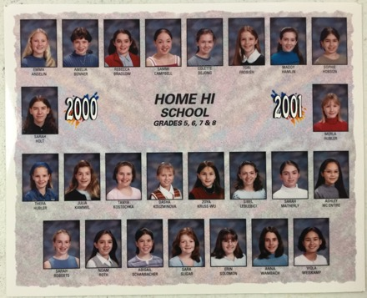
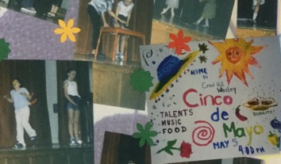
2000-2001
There were 25 people total in the year 2000-2001
The students had some field trips we do today,
such as Allerton, museums, and the Engineering Open House.
There was a Cinco de Mayo talent show celebration. They also performed a play called “North Side, South Side Story” set during the Civil War.

Slide 7
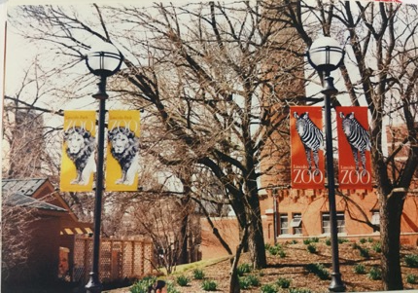
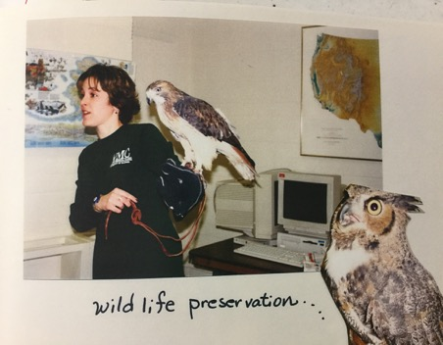
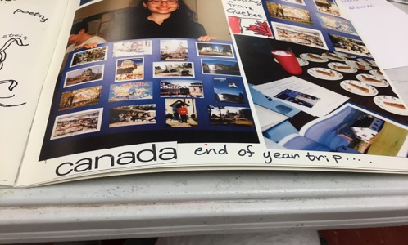
2001 - 2002
The students traveled to the Chicago Art Institute.
The 7th and 8th graders did a project on the Civil Rights video.
The wild life preservation came into visit
The girls went to Lincoln Park Zoo in Chicago.
They went to Quebec, Canada for the end of the Year trip!!

Slide 8
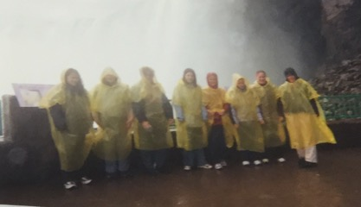
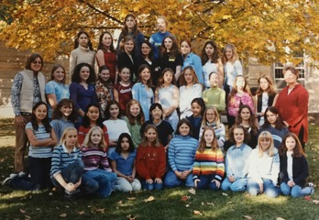
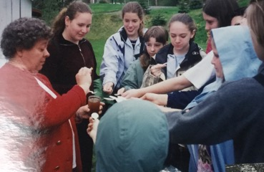
2002 - 2003
The students took field trips to Chinatown, Chicago, the Lincoln Park Zoo, and the Indianapolis Art Museum.
They had a school garden and prepared lunches using ingredients from it.
Home Hi had 39 students by this year.
One class went to Niagara Falls. They also went to Dufferin Terraces, Canada.

Slide 9
2003-2004
CMS was in the basement of Wesley United Methodist Church in 2003 and 2004.
They went to see Twelfth Night and they read the book like we did in 2017.
They made a human sitting chain during a lecture and we still do that today at Allerton as a team building activity.

Slide 10
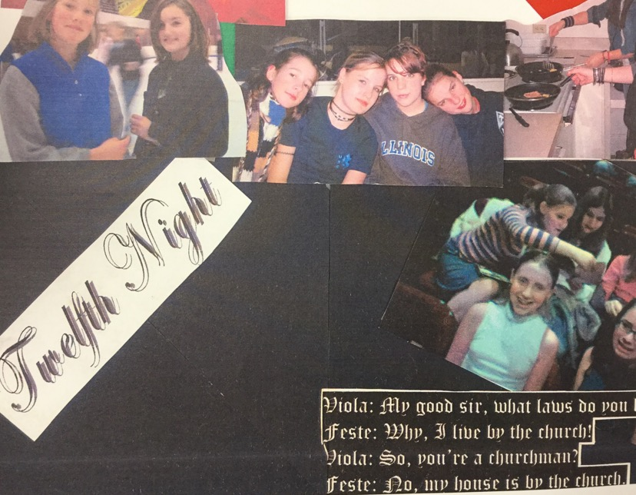
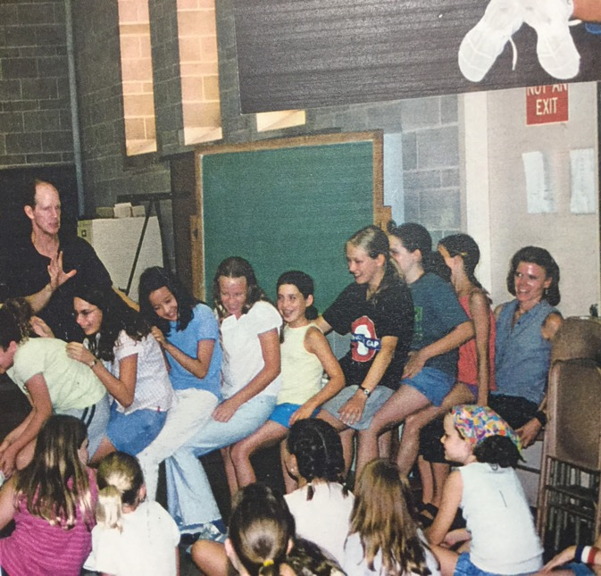
2003-2004 pictures

Slide 11
2004-2005
Home Hi (CMS) had 4th and 5th grade.
They took a school wide field trip to the Indianapolis Zoo.
There were 7 people on the yearbook committee, which is the same number as we have now.
They did knitting, like we still do now.
They did keyboarding, and we currently do keyboarding in 6th grade as well.
They visited Allerton, ChinaTown in Chicago, and Peoria Wildlife Prairie Park.

Slide 12
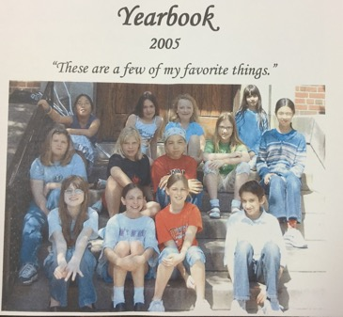
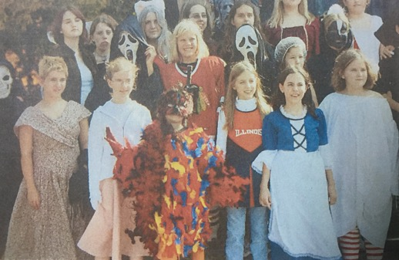
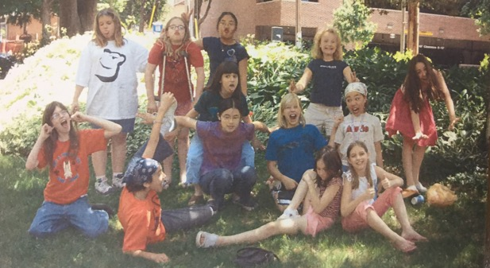
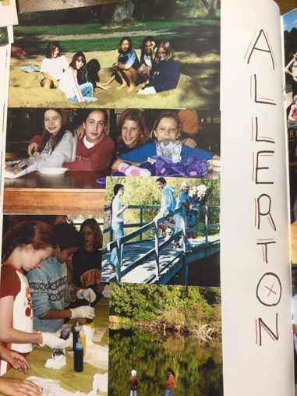
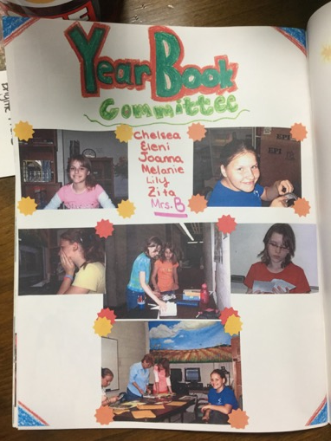
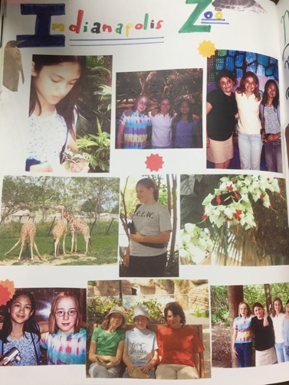
2004
-
2005

Slide 13
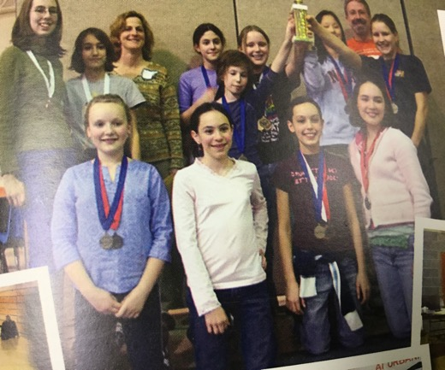
2005-2006
Home Hi changed its name to CMS (Campus Middle School for Girls).
It was still a 5th through 8th grade school.
They still had the Science Olympiad.
The whole school went to Indianapolis and Chicago.
For forum week, they learned about the media.
They also had a Dinner Theater performance and celebrated Mozart’s 250th birthday
The director of the school was Rhonda Cromwell

Slide 14
2006-2007
In the years 2006-2007, the CMS students had both a cross country/track team where Claire got second at state, and had a science olympiad. They also had a concert where they sang “The Hills Are Alive With the Sound of Music”, had a Tea Class 101, went to Chinatown, and had a dinner theater. They also had an art club that year. Someone from Barnum and Bailey came in at an assembly to entertain.

Slide 15
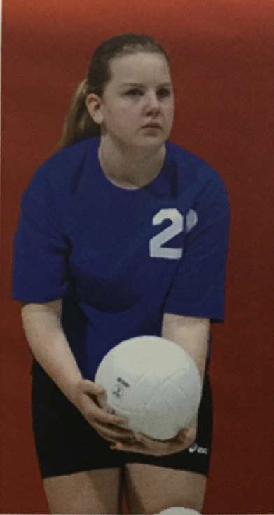
2007-2008
For Halloween they went to Alma Mater.
Chicago field trip
They went to the state capital.
Ice skating field trip
Forum week: Global Warming
6th grade went to Salem
One class hatched ducklings
Dinner theater performance
Talent show
CMS started a volleyball team

Slide 16
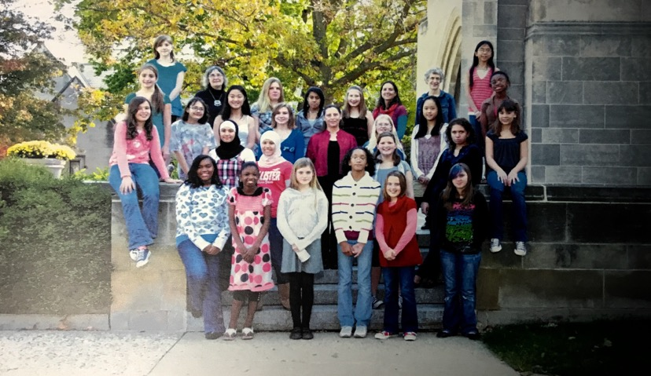
2009

Slide 17
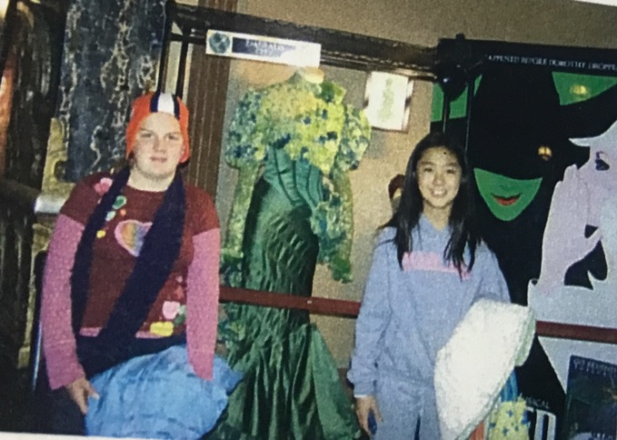
During 2009 the entire CMS school took a trip to Chicago during the winter where they ice skated and viewed the musical Wicked.
2009

Slide 18
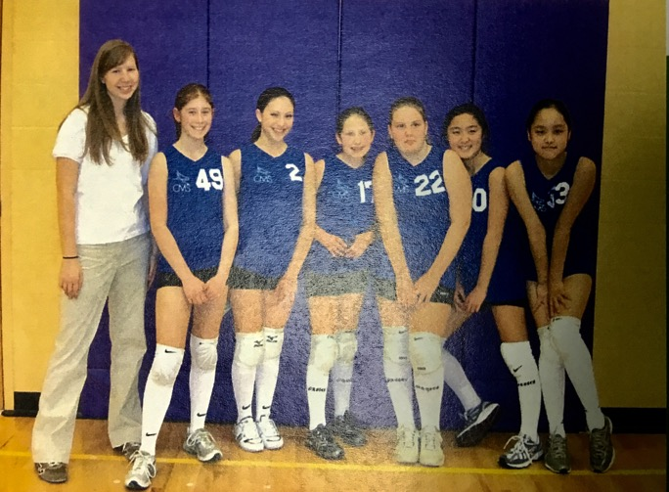
On February 2, 2009 both CMS volleyball teams made CMS history. They won both games against the school Next Generation.
2009

Slide 19
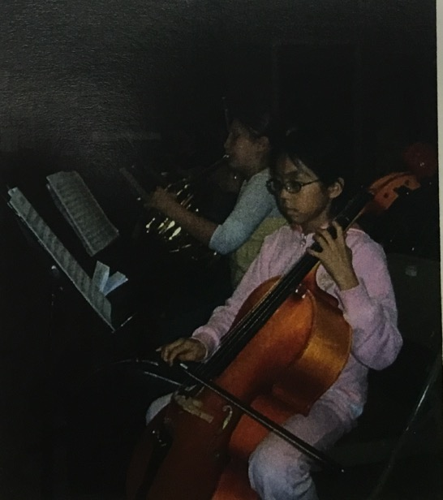
CMS had many after school programs including, French Club, Art Club, Ensemble, and SSAT where the students learned test-taking skills.
2009

Slide 20
2010 and 2011
In these years at CMS the the school had a talent show. The eighth graders were collecting the profits from the talent show and decided to give it to the flood victims in Pakistan.
Some of the after-school clubs that CMS had were: Entrepreneur Girls Rock, Robotics, Ensemble, and Volleyball.
Mrs. Adams, the school director now, started teaching 7th grade at CMS.

Slide 21
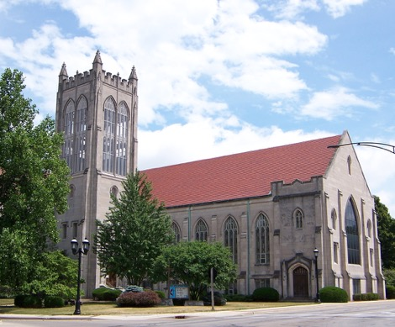
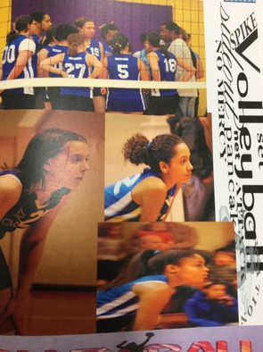
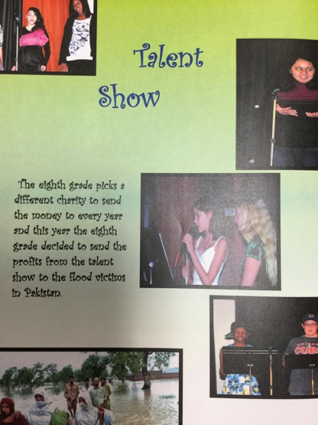
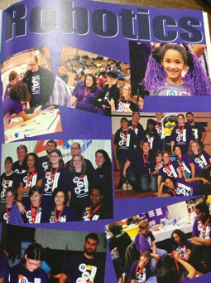
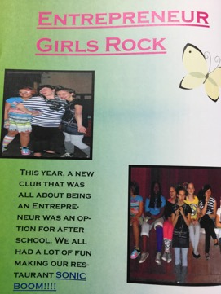
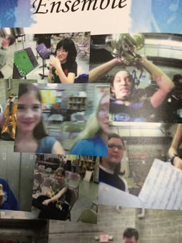
School
2010-2011

Slide 22
2012 and 2013
In 2013, all students of CMS went to the Chicago Art Institute. In May of 2013, the CMS students went to Mahomet to celebrate the end of the school year to learn how to identify trees at the Museum of the Grand Prairie’s Barking up the Wrong Tree program. The CMS students had a talent show in which they raised $693. In the yearbook, there was a backwards “c” and “s”. The only letter that the alumni of that time got right was the “m”.

Slide 23
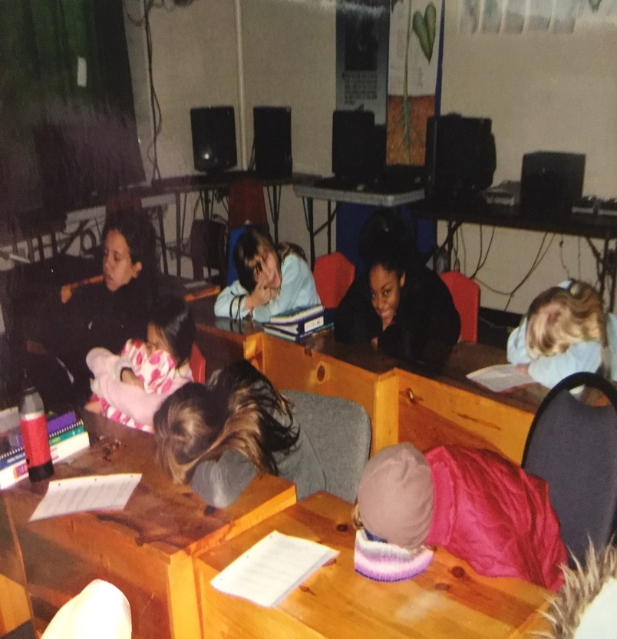
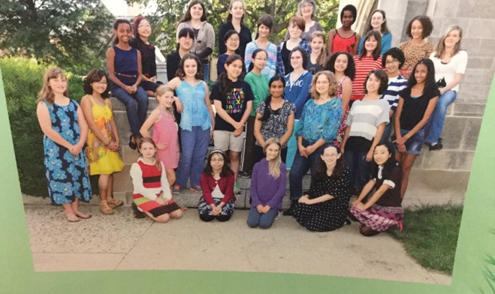
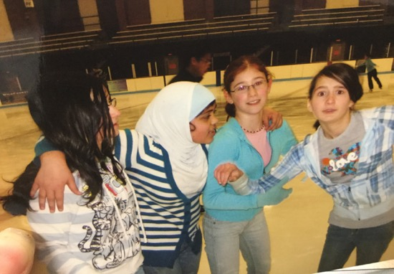

Slide 24
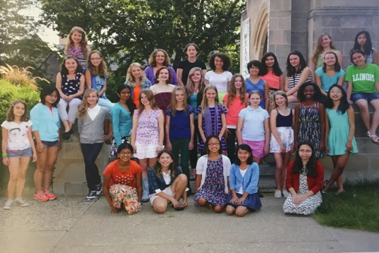
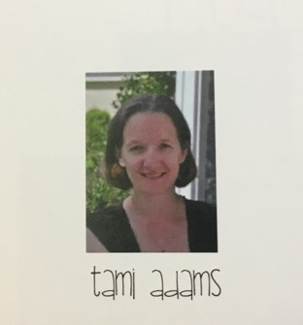
Years 2013-2014
There were 33 girls at CMS.
CMS was still located in the Wesley Foundation.
Tami Adams became the executive director of CMS.
The students put on a dessert theater.

Slide 25
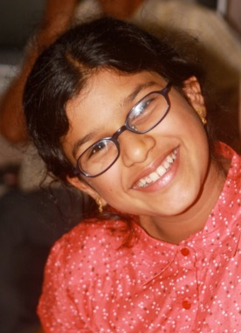
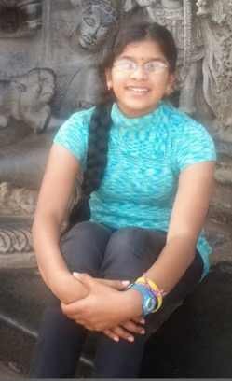
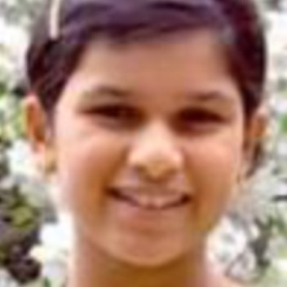
In Loving Memory of Prama Pramod
She was born March 30th, 2002 and died on February 9th, 2014 due to sickness.
One of the staff members, Sara, said that Prama always wore a smile on her face.

Slide 26
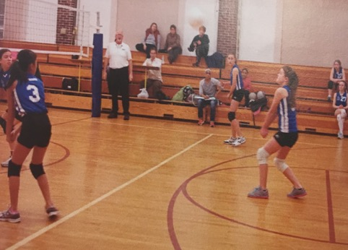
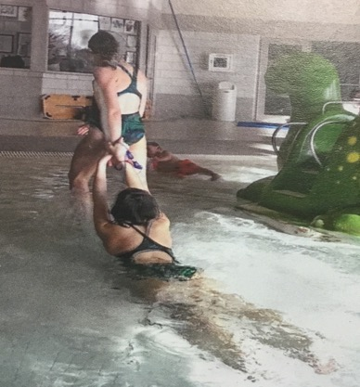
Years 2014 - 2015
In December, CMS had a indoor pool party at the Urbana Indoor Swimming Pool.
The Robotics Team went to state on January 24th and won 6th place.
The Falcons volleyball season started in January.

Slide 27
2014-2015
CMS did an event called “the Hare Raising Race” in 2015.
For forum week in February, the girls learned about theater and Krannert specialists visited to help them.
In May, the girls had lots of fun at the Indianapolis children’s museum.
In the girls’ art classes, they made bowls for the empty bowl fundraiser.

Slide 28
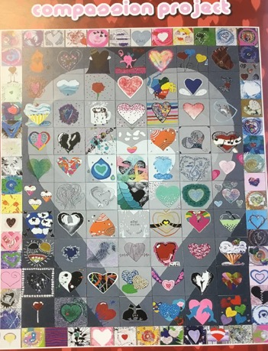
Years 2015 - 2016
The eighth graders got to go to Springfield to an environmental rally.
The CMS students went to the Art institute of Chicago.
CMS worked on the compassion project.
It was the first year that CMS had to have two sixth
grade classes instead of just one.

Slide 29
Years 2016 - 2017
CMS teamed up with Prof. Trish Gregg to learn about volcanoes at the bottom of the ocean. She took some of CMS’s experiments to the bottom of the sea, and CMS went to Shedd Aquarium to learn more about the fish she would see on her trip.
CMS found a new location! It moved to 108 S Webber St, Urbana IL.
Forum Week was about creating an app to help people. Students created a poster which showcased their app’s abilities.

Slide 30
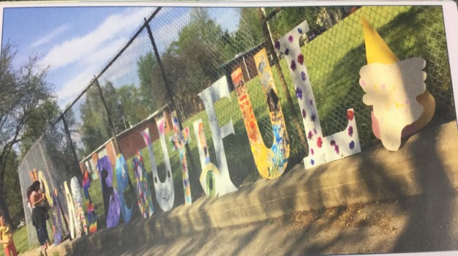
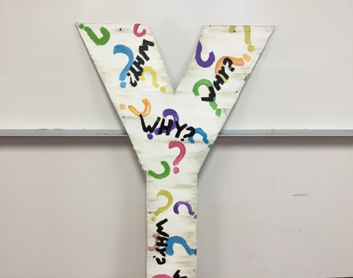
2017-2018
CMS’s theme for the year was “You Are Beautiful.” Advised by Ms. Traci, the whole school got into groups and each group designed and painted a giant wooden letter out of the words “You Are Beautiful” and hung them outside on the fence.
The “Y” from the “You Are Beautiful” sign went missing, so some students made a new “y.”

Slide 31
2017-2018
Both the sixth graders and eighth graders formed a school walk-out to honor the students that had been killed in the school mass shooting in Florida.

Slide 32
2017-2018
The CMS school got to FaceTime with former governor of Arizona, Janet Napolitano!

Slide 33
The eighth grade math teacher, Dr. Hübler, passed away. He was only 62 years old. He had been teaching at CMS for 24 years.
Dr. Hübler

Slide 34
Years 2017 - 2018
In the sixth grade art class, a student’s mom came in to help the students make clay pottery lanterns with the glaze and everything!
The Robotics Team, The Marine Machine, directed by P.J. Patterson (Jocelyn’s dad), won a judge’s award in the year’s theme of hydrodynamics. Coming in second, they moved on to state.

Slide 35
2017-2018
For Forum week, the students re-enacted scenes from Shakespeare’s Twelfth Night.
This year had the largest sixth grade class in the entire history of CMS!

Slide 36
Years 2018-2019
Current Year!
CMS acquired a long arm quilter.
25th anniversary of CMS.
CMS had a 25th anniversary luau on September 28th, 2018. There were ponies from the Trinity Horse Foundation, and performances from Community Center for the Arts, the Urbana Dance Company, Girls Next Door A Cappella, and hula hooping by Satina Entertains. Food was provided in the form of snow cones from Kona Ice, and other food from Piato catering.

Slide 37
Years 2018-2019
There was a video about CMS on WCIA News. It was published November 12th, 2018. The video talked about the 25th anniversary of CMS.
CMS made a tree for the Festival of Trees, November 17th, 2018. The tree‘s theme was “You Are Beautiful” and all of the ornaments were made by CMS students.
CMS saw the movie “On the Basis of Sex”, about Ruth Bader Ginsburg.

Slide 38
Pictures 2018-2019

